Slide 1
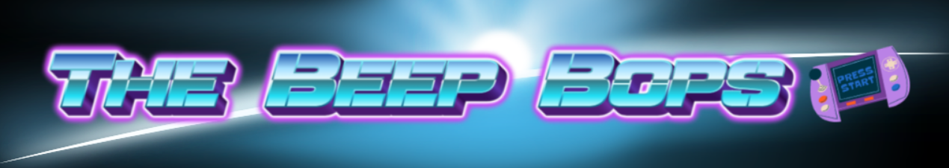
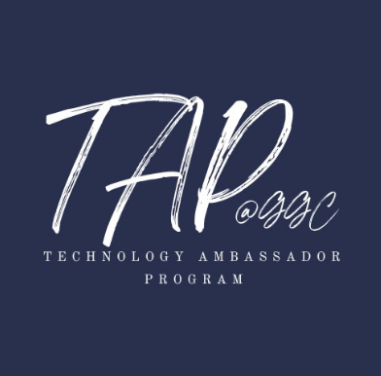
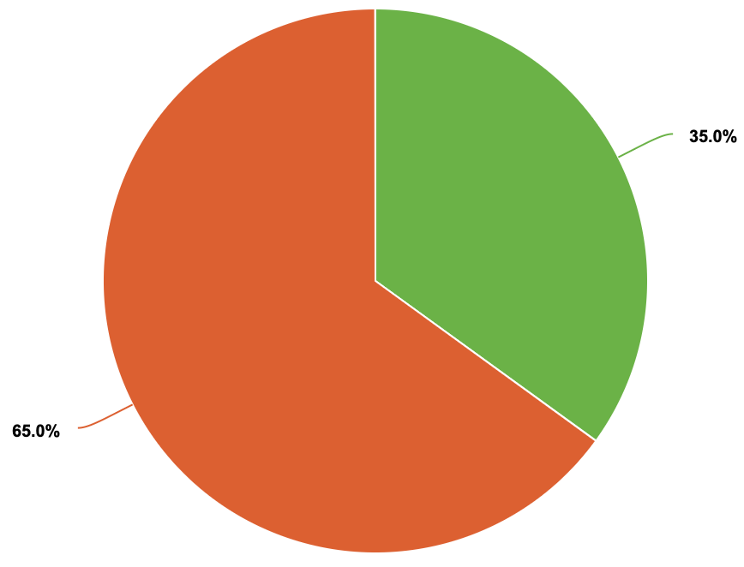
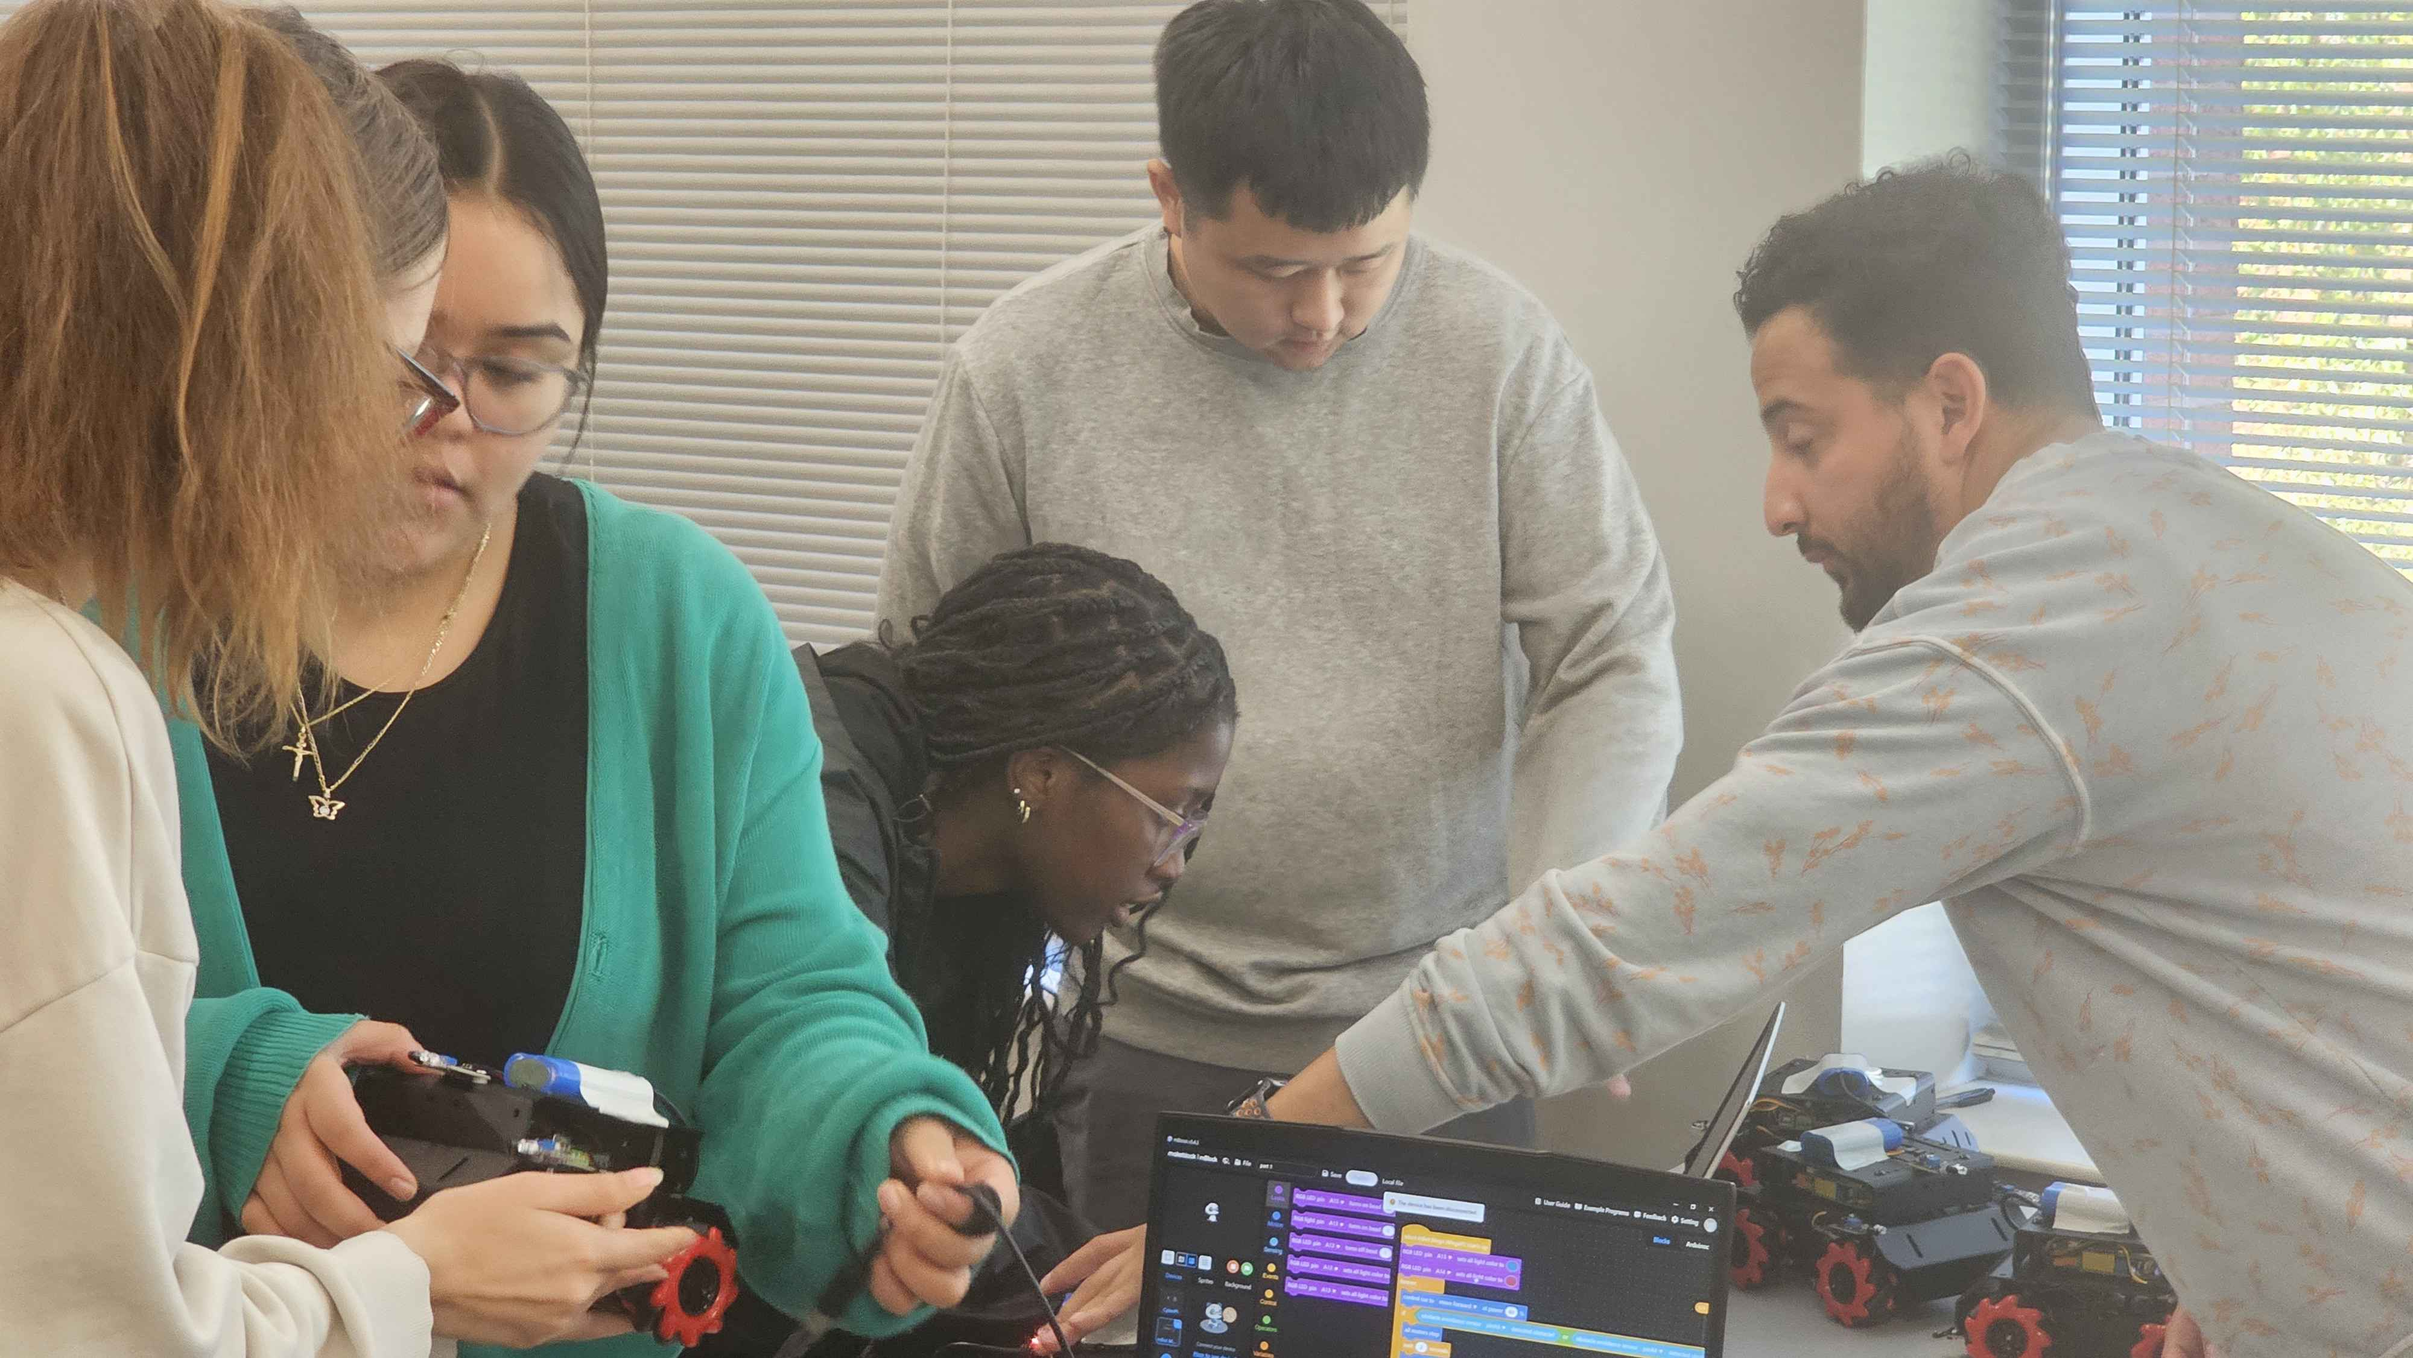
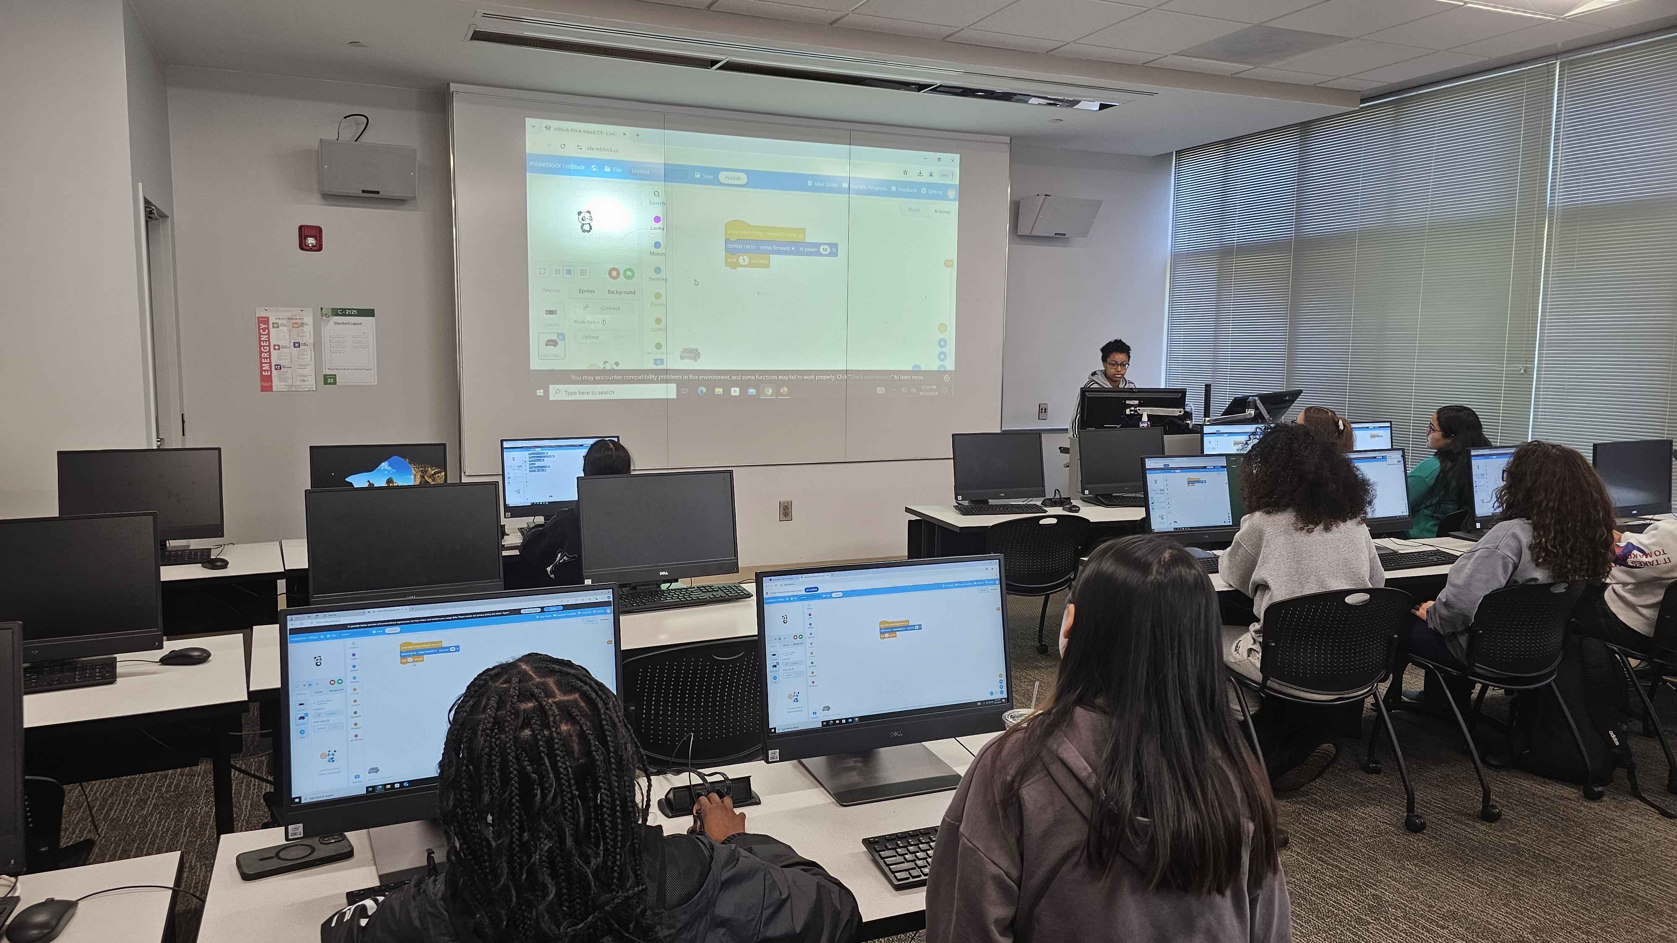
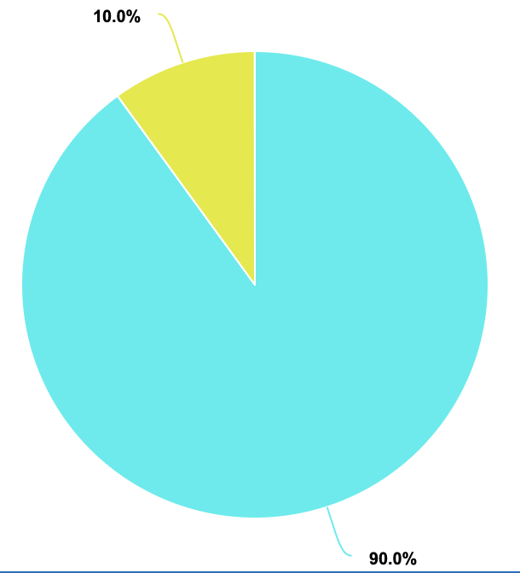
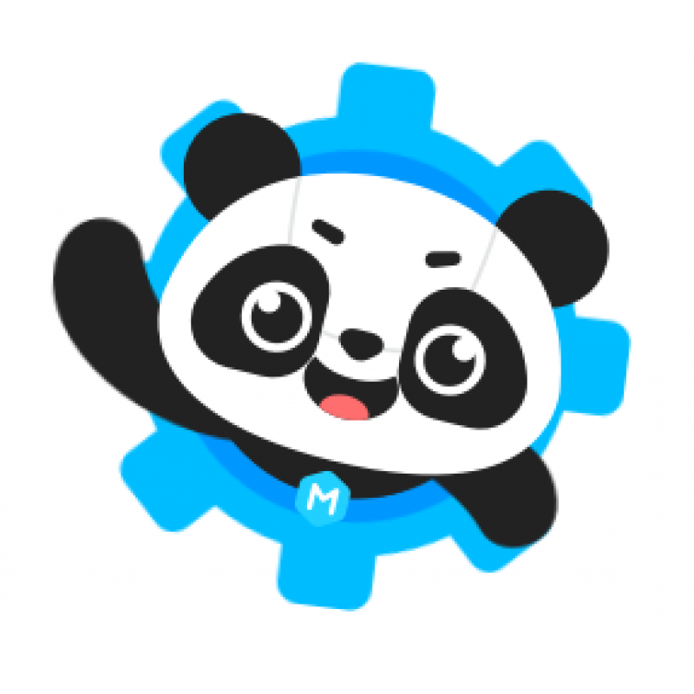
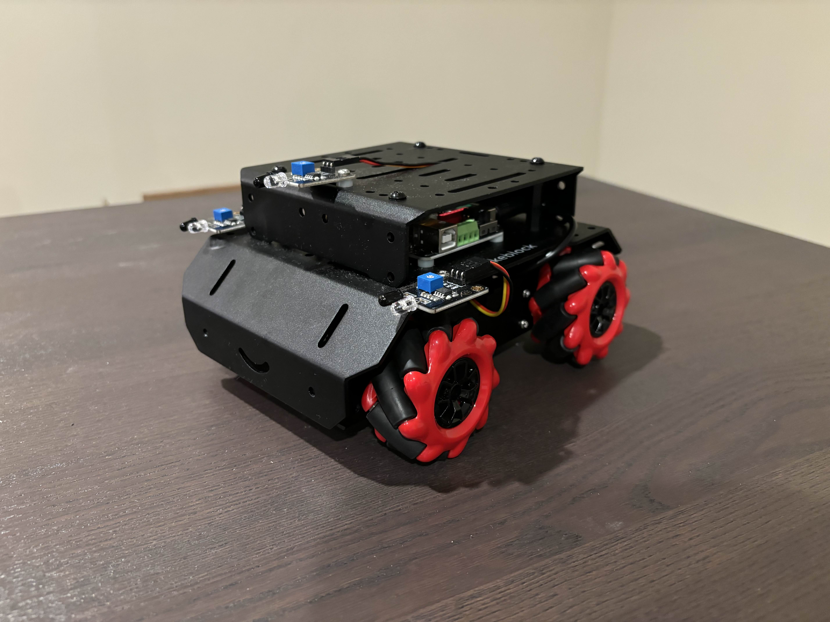
mBots on the move!
Sanaa Boddie, Hector Cruz, and Jay Tak | Dr. Robertson and Dr. Gunay | Georgia Gwinnett College
What is TAP?
Technology Ambassador Program (TAP) is a project-based class that provides a collaborative environment for students to work with their fellow classmates on a semester-long project using technologies of their choice. TAP strives to increase participation in IT through numerous outreach activities and workshops that are designed to showcase the creative and fun side of technology.
Project Description
We decided to go with using the mBot because we wanted to have a physical interaction with the code by having it uploaded on the bot and seeing what the code does in a real-world scenario.
Our project consisted of using the makeblock coding software along with the mBot Mega.
We presented the necessary information about coding in order for the attendees to understand the basics of coding and programming.
Results Based on the provided results, we can see that for the pre survey only 10% of the people knew what a nested if statement was, and we saw a 55% increase with post survey showing that 65% of the people were successfully able to answer what a nested if statement was.
Furthermore, we saw that a staggering 90% of the audience were at least somewhat curious about programming after the workshop.
We can conclude that our end our workshop was enjoyable and sparked great interest in programming, however, we need to do a bit better of a job in explaining what more complex programming ideas like nested ifs are and how they work.
(Green is Correct, Orange is Incorrect, Teal is Curious, and Yellow is not Curious)
Our Goals
Our main goal is to create a project that is accessible for anyone of all ages. We wanted to be able to reach a large audience and by showing them how simple technology can be we hope to inspire more people to take interest in the field. Our project was to try to teach people about coding and how it works. This was done
Workshop Description
We provided 3 different scenarios for our attendees to undertake with our guidance. The first part was just to get the bot to move forward and then backward. After this was done, we continued our presentation and expanded upon what was covered by introducing new coding concepts like if statements. After a brief explanation of the new concepts, we had the audience create a code where the bot moves and when it encounters an object in its path, it will detect it, stop, back up, and then turn away from the obstacle again all under our guidance as we want all participants to reach the final code necessary to achieve this. Lastly, for the final challenge we had the attendants modify the code performed in step 2 and allow them to explore and add new lines if desired and have them complete an obstacle course that we created. This part would not be as handheld as the previous ones, but we of course walked around and answered questions anyone may have had. If time allowed, we would have 2 different bots race to the finish on our course.
References & Acknowledgements
Makeblock. (n.d.). Robot Kits & Laser Cutters for Steam Education. Makeblock. https://www.makeblock.com/
Makeblock. (n.d.). One-stop coding platform for teaching and learning. mBlock. https://mblock.cc/
Makeblock. (n.d.). Search results for “line order:likes.” Makeblock Forum. https://forum.makeblock.com/search?q=line+order%3Alikes
GGC TAP committee and the School of Science and Technology

